Slide 1
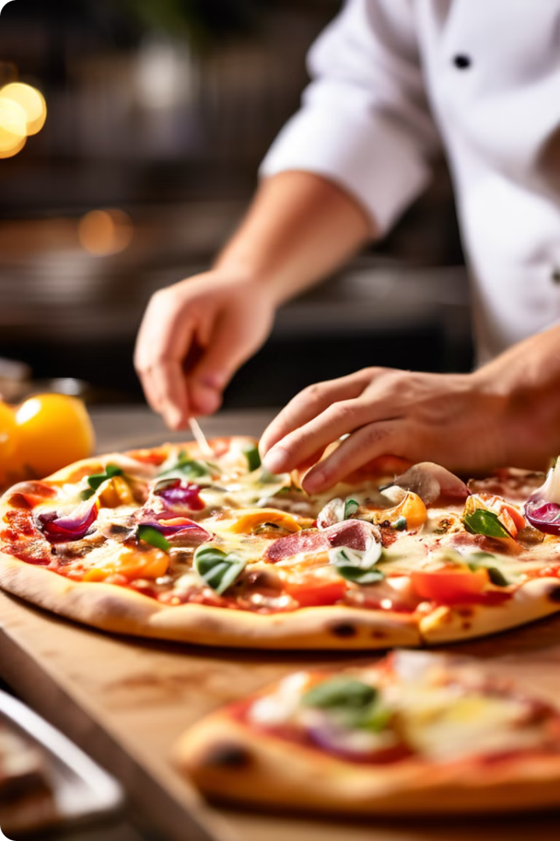
Pizza Price Prediction
By Aniket Bangar

Slide 2
Index
1
Introduction
2
Objective
3
Process flow
4
Tools and Platform Used
5
Source of data and Data Description
6
Data Processing
7
Correltion
8
Data Visualisation
9
Importance of features
10
Challenges
11
My contribution and Decision tree
12
Conclusion

Slide 3
Introduction
In today's competitive market, understanding the factors that influence pizza prices is crucial for businesses in the food industry. By leveraging machine learning techniques, we can develop predictive models that can assist in pricing strategies, cost optimization, and customer satisfaction.
One of the key benefits of pizza price prediction is the ability to offer transparent and consistent pricing to customers.
By applying advanced machine learning techniques to pizza price prediction, businesses can unlock valuable insights and make data-driven decisions that were previously challenging or impossible.

Slide 4
Objective
Develop an accurate and reliable machine learning model to predict pizza prices based on various features such as toppings, size, extras, and other relevant attributes.
Analyze the impact of different features on pizza prices and identify the most significant factors influencing pricing decisions.
Optimize cost structures and profitability by understanding the relationship between pricing, ingredients, and operational costs.

Slide 5
Data Collection and Preprocessing
Gathering and preparing pizza data for analysis.
Data Sources
Data Cleaning
Feature Extraction
Restaurant menus, online ordering platforms, customer reviews.
Removing duplicates, handling missing values, and formatting data.
Identifying relevant variables for price prediction.

Slide 6

Process Flow
Transforming raw data into meaningful features for the model.
Data Collection
1
2
Data Pre-Processing
Data Visualization
3
4
Conclusion and Suggestions
Applying Supervised algorithm
5

Slide 7



Tools and Platforms Used
Jupyter Notebook
Python
Machine Learning Algorithms
An open-source web application for creating and sharing documents that contain live code, visualizations, and narrative text.
A versatile and powerful programming language widely used in data science, machine learning, and scientific computing.
Advanced algorithms and techniques used to train predictive models and extract insights from complex data.

Slide 8
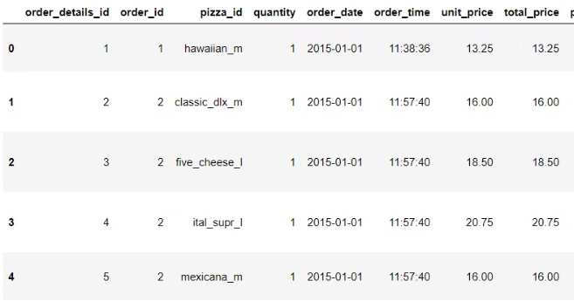
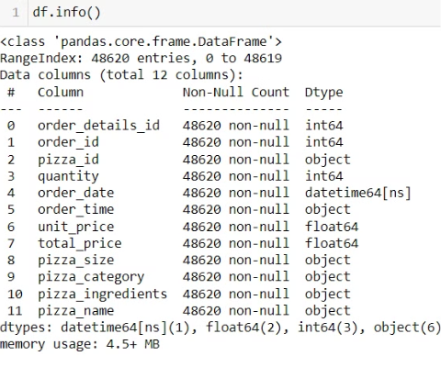
Source of the data
Data Type
The data set contains 48000 records in total
Data types contains integer and float

Slide 9

Model Selection and Training
Choosing and training a machine learning model.
Linear Regression
Decision Tree
A simple model for predicting continuous values.
A tree-based model for making predictions based on decisions.
Random Forest
An ensemble of decision trees for improved accuracy.

Slide 10
Data Description
order_details_id: A unique identifier for each individual order item.
order_id: A unique identifier for each order, linking multiple order items to the same order.
pizza_id: A unique identifier for each pizza variant.
quantity: The number of pizzas of the same variant ordered.
order_date: The date when the order was placed.
order_time: The time when the order was placed.
unit_price: The price of a single pizza of the given variant.
total_price: The total price for the quantity of pizzas ordered, calculated as unit_price * quantity.
pizza_size: The size of the pizza ordered (e.g., small, medium, large).
pizza_category: The category or type of pizza (e.g., vegetarian, meat lovers, classic).
pizza_ingredients: The list of ingredients or toppings used in the pizza.
pizza_name: The name or description of the pizza variant.

Slide 11
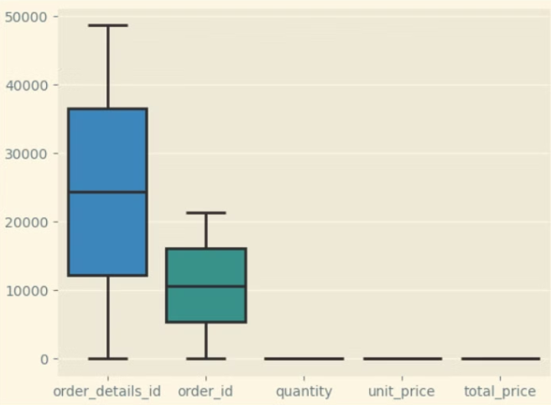
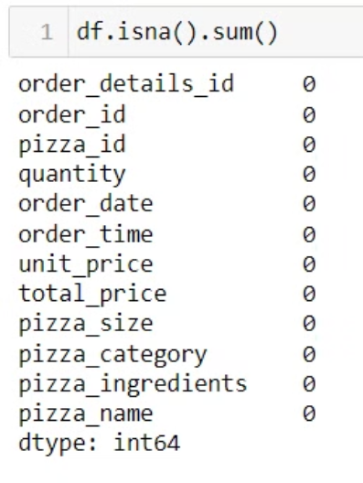
Data Processing

Slide 12
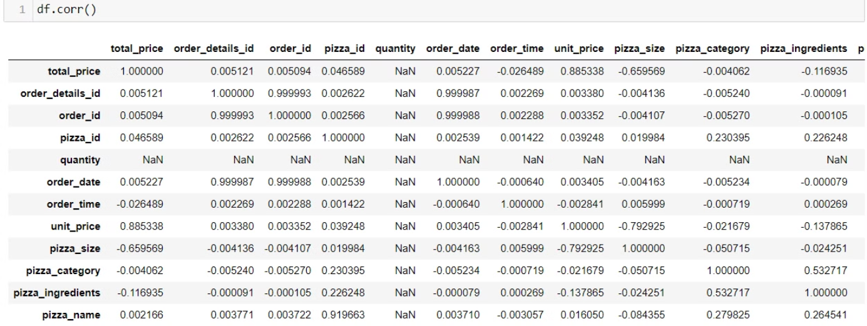
Correlation Matrix

Slide 13
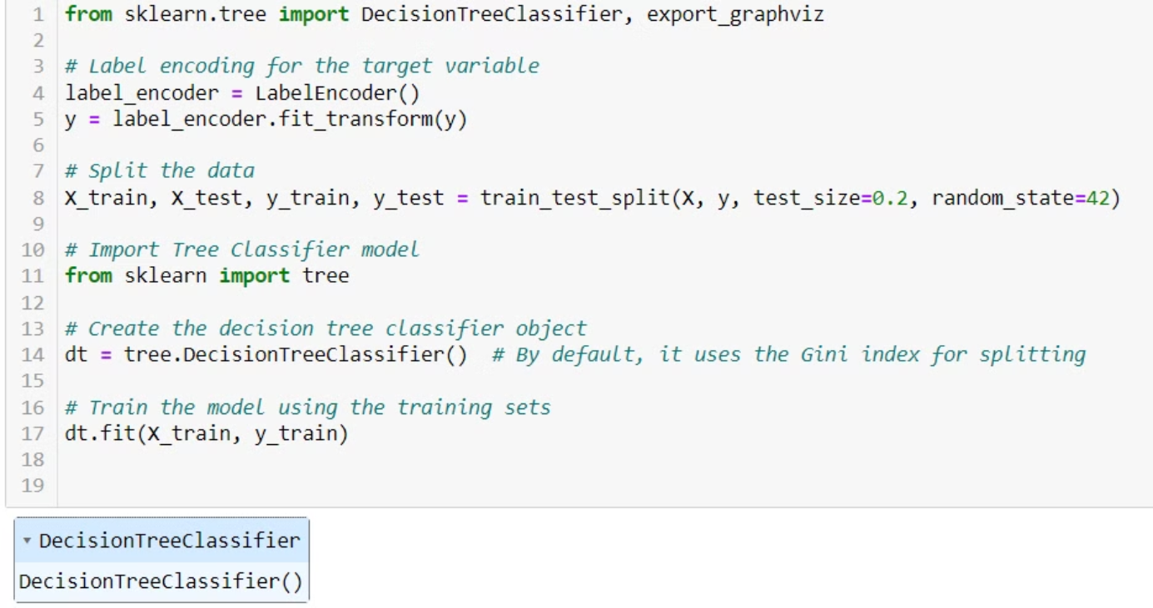
Decision Tree

Slide 14
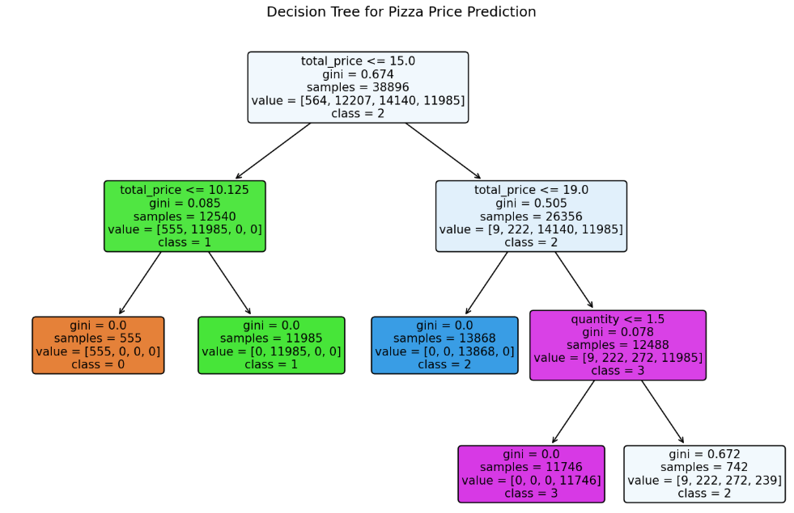
Decision Tree

Slide 15
Challenges
Very large and complex data set
Domain knowledge required to apply models
Data understanding

Slide 16
My Contribution
spent the time on data processing using Algorithms – Linear Regression,Decision tree
Checked accuracy of all 2 algorithms and found best suitable model is Decision Tree
Train accuracy – 79%

Slide 17
Conclusion
By leveraging machine learning techniques and a comprehensive pizza dataset, we aim to develop a reliable predictive model for pizza prices. This model will empower pizza companies to make informed decisions, optimize their operations, and enhance customer experiences, ultimately driving business growth and success in the competitive food industry.

Slide 18

Thank You!

